Slide 1
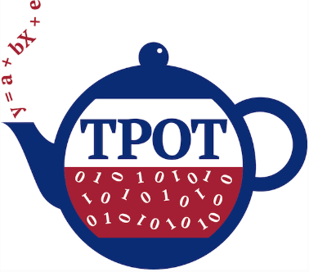
Knowlede Sharing Session Automl Aug 05, 2020

Slide 2
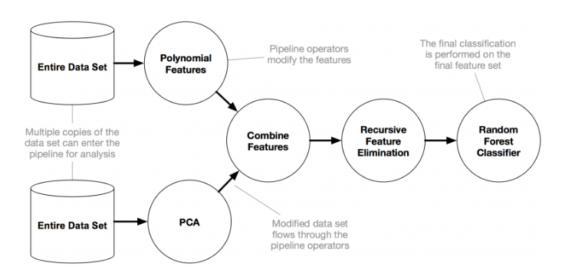
Introduction- TPOT
Knowledge Sharing Session
TPOT: A Tree-Based Pipeline Optimization Tool for Automating Machine Learning
Fig. An example TPOT pipeline

Slide 3
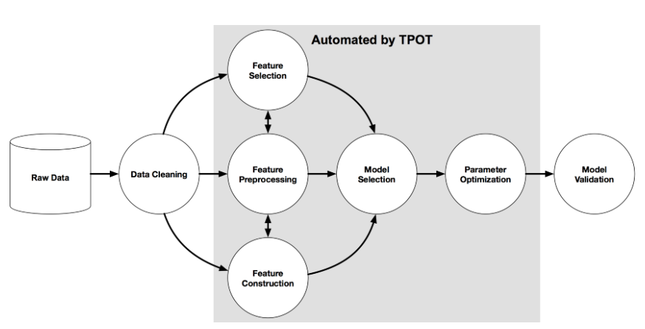
Introduction- TPOT
Knowledge Sharing Session
TPOT will automate the most tedious part of machine learning by intelligently exploring thousands of possible pipelines to find the best one for our data.
Once TPOT is finished searching, it provides us with the Python code for the best pipeline it found so we can tinker with the pipeline from there.

Slide 4
Working & Features- TPOT
Knowledge Sharing Session
TPOT tries a pipeline, evaluates its performance, and randomly changes parts of the pipeline in search of better performing algorithms.
AutoML algorithms consider:
Multiple machine learning algorithms (random forests, linear models, SVMs, etc.) in a pipeline
Multiple preprocessing steps (missing value imputation, scaling, PCA, feature selection, etc.)
Hyperparameters for all of the models and preprocessing steps
Multiple ways to ensemble or stack the algorithms within the pipeline
TPOT uses genetic search algorithm to find the best parameters and model ensembles.
TPOT is built on the scikit learn library and follows the scikit learn API closely.
TPOT is open source, well documented, and under active development.
This can work on cluster as well as local systems, however running on local might take some extra time depending on the parameters.

Slide 5
Auto-Sklearn Introduction
Knowledge Sharing Session
“auto-sklearn is an automated machine learning toolkit and a drop-in replacement for a scikit-learn estimator”
Auto-sklearn provides out-of-the-box supervised machine learning.
Built around the scikit-learn machine learning library, auto-sklearn automatically searches for the right learning algorithm for a new machine learning dataset and optimizes its hyperparameters.
Thus, it frees the machine learning practitioner from these tedious tasks and allows them to focus on the real problem.
It leverages recent advantages in Bayesian optimization, meta-learning and ensemble construction.

Slide 6
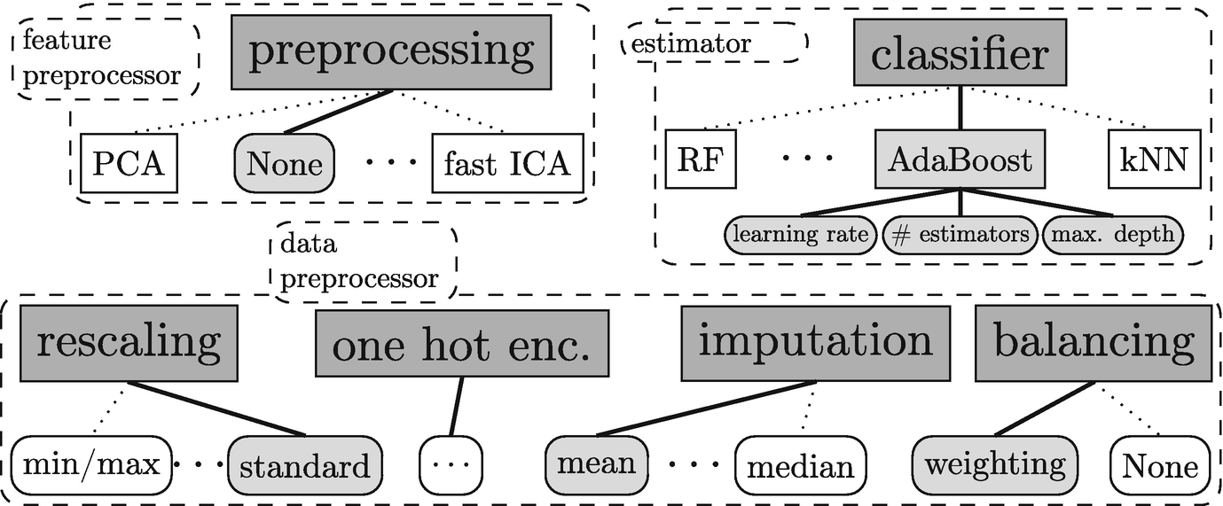
Auto-Sklearn
Knowledge Sharing Session

Slide 7
Auto-Sklearn Working
Knowledge Sharing Session
Auto-sklearn builds an ensemble of all models tested during the global optimization process.
Auto-sklearn wraps a total of 15 classification algorithms, 14 feature preprocessing algorithms and takes care about data scaling, encoding of categorical parameters and missing values.
Auto-sklearn is open-source and development is done on github.
We need to work on cluster as auto-sklearn works on linux environment.

Slide 8
Thank You! ☺

